Slide 1
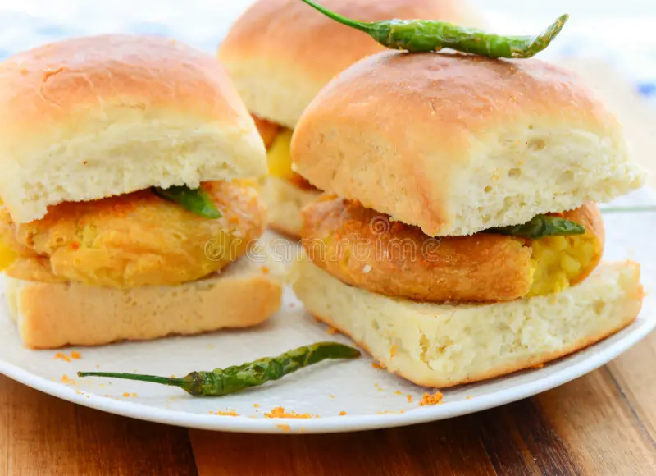
CASE STUDY – VADA PAV (A study for new vada pav shop in Shivaji Nagar, Pune )
Created By – MAHESHWARI

Slide 2
INTRODUCTION :- PROBLEM – A man wants to open a Vada pav Shop near Shivaji Nagar in Pune. He has got a location where there are 4 other vada pav shops are there. He is not able to understand what will be the strategy to take over his clients.
ANALYSIS
Starting a vada pav outlet does not involve much investment.
Government licensing fee is also nominal.Also the raw materials are easily available .
The switching cost, in case if the business does not make well in profit is also very small.
Vada pav is been associated with Mumbai and tourists want to taste Mumbai Vada pav. Different varieties is been initiated to try new addition.
Outlets has been opened at places that are usually thronged by locals and tourists.

Slide 3
A . PRICING

Slide 4
B. DIFFERETIATION
AMENITIES | SOCIAL MEDIA PLATFORM | DELIVERY | PAYMENT MODE
Out –door seating AC and Non-AC | Instagram | Online delivery | Cash
Free Take away | Facebook | Zomato | BHIM
Serves Non-Veg | WhatsApp order | Swiggy | UPI
E-wallets available | Just dial order | Food Panda | G-PAY
Parking available | Word Press Food Blogs | Quick service quality | PHONE PAY
Affordable Price with different types of combo
High hygiene with variety offerings
Strong branding and local market deep knowledge

Slide 5
C. COMPETITORS ANALYSIS SWOT ANALYSIS-
STRENGTH | WEAKNESS | OPPORTUNITY | THREATS
Strong Market Position. | Lack of Financial and Technical resources. | Increase demand of theme parks | Intense Domestic and International competition.
Innovative concept | Presence of large number of indirect competitors | High internet penetration
Strong business models |  | Increased Mobile phone usage.
Large customer race and Geographical out reach.

Slide 6
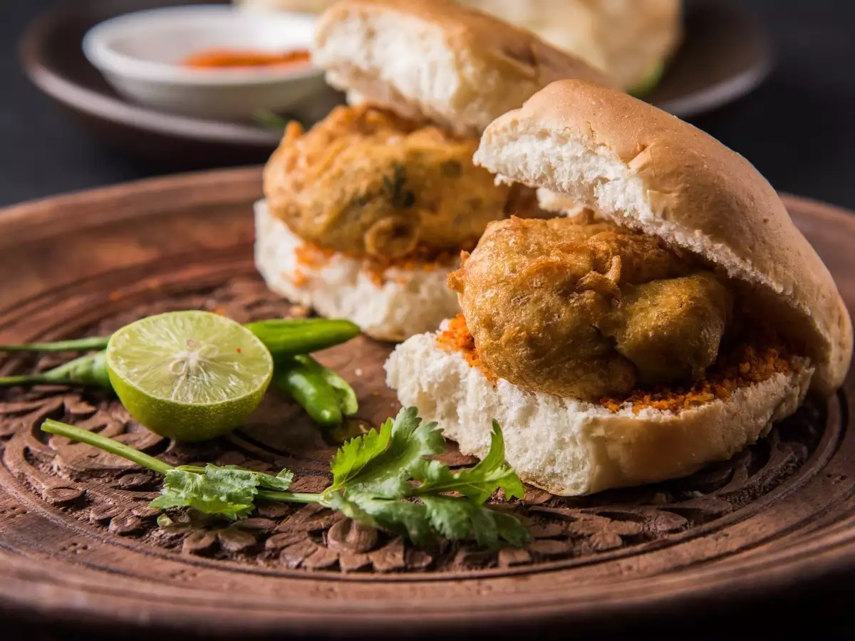
D. POSITIONING
A good quality product with different variety.
Standard raw material and fresh food for customers.
Middle and low income group people.
Mainly students, couples and employees.
Clean and hygiene branded Vada- Pav.
Low Price with best quality compare to others.
Best services and Amenities compared to others.

Slide 7


